Slide 1
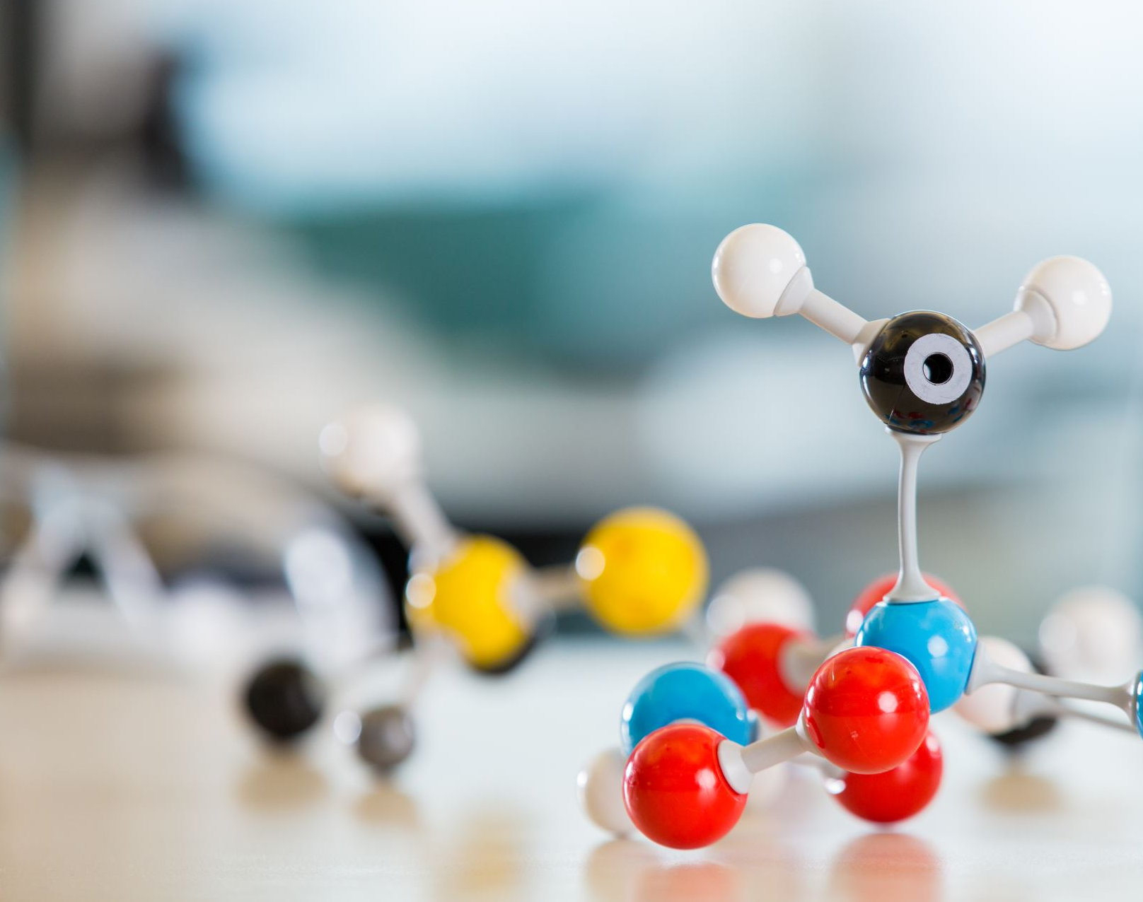
Chemistry lesson
Notes:
(voice: charles)
`Na`, a metal, loses one electron to become an `Na+` cation while `Cl`, a non-metal, gains this electron to become `Cl−`. The ions are held together due to electrostatic attraction, and compound `NaCl`, or common table salt, is formed.

Slide 2
Sacrilegious
Difficult words
Notes:
(voice: karen)
The word Sacrilegious is spelled `Sacrilegious`

Slide 3
Stock market report
Notes:
(voice: Dustin)
The 5 most volatile stocks on a daily basis in 2019 were `AMD`, `CELG`, `RMD`, `ARNC` and `NVDA`

Slide 4
Proper writing
Notes:
(voice: Helen)
When writing a question, remember to add the `?`

